Slide 1

Managing Alfresco source code
Samuel Langlois 27 April 2017
Notes:
Samuel Langlois; Build Manager at Alfresco
Job is to take care of CI and releases

Slide 2

Agenda
Source
Continuous integration
Releases

Slide 3
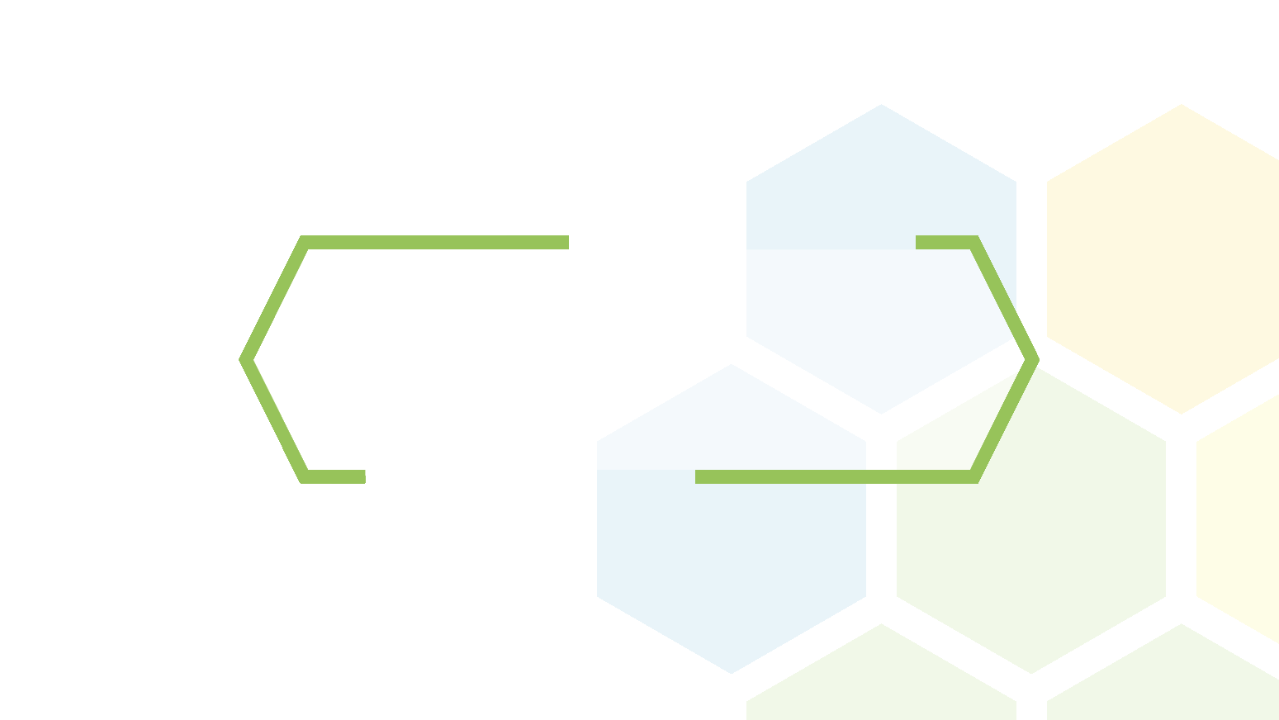
Source
Details

Slide 4
Challenges 1/3 : quantity
~ 1.5 million lines of code
Spread in 100s of repositories
Multiple languages
Java
Javascript
C++ / C#
ObjectiveC
Notes:
Huge and diverse code base

Slide 5
Challenges 2/3 : access rights
Public code – Community editions
Private code – Enterprise editions, paid-for add-ons, …
Internal code – Cloud editions, feature branches, …

Slide 6
Challenges 3/3: non-linear release lines
Release 5.1.0
Hotfix 5.1.0.1
5.1.0 branch
5.1.1 branch
5.1.N branch
Release 5.2.a
Release 5.2.b
Release 5.2.0
trunk

Slide 7

Storing it
Subversion! https://svn.alfresco.com/repos/alfresco-enterprise/
Open-source mirror: https://svn.alfresco.com/repos/alfresco-open-mirror/

Slide 8
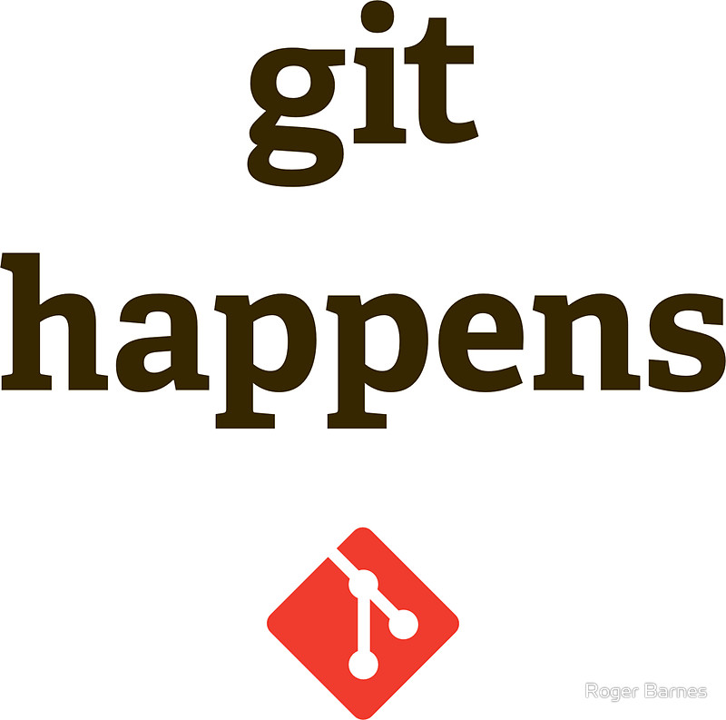

Slide 9

Git migration
Activiti
Mobile
Integrations
Media Management
Records Management
Search
…
In progress…
Repository
Share

Slide 10
Git migration - Repository
Migrated to git
alfresco-core - https://github.com/Alfresco/alfresco-core
alfresco-data-model - https://github.com/Alfresco/alfresco-data-model
To be migrated
alfresco-jlan
alfresco-repository
alfresco-remote-api
…

Slide 11



Which git?
GitHub https://github.com/
« old » GitLab CE https://gitlab.alfresco.com/
« new » GitLab EE https://git.alfresco.com/
In progress…
In progress…
Notes:
GitHub, good for visibility, getting contributions
Old gitlab CE
New gitlab,

Slide 12
Technical challenge 1/2
« new » GitLab EE not able to accept external users yet
Looking for solutions to handle identities…

Slide 13
Technical challenges 2/2
Repositories with different access rights
Folders (RM, …)
Branches (RM, Search, …)
Partial push
Pull requests

Slide 14
Continuous integration
Details

Slide 15

Atlassian Bamboo
1 server
21 linux build agents
2 Windows
2 OS X
Notes:
WHY NOT JENKINS?

Slide 16

FAQ – Jenkins?
Notes:
WHY NOT JENKINS?

Slide 17
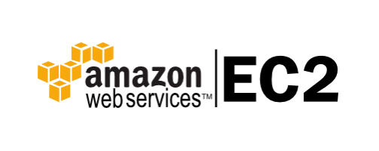
Superscaling Bamboo!
16 « fixed » build agents
5 « elastic » agents on AWS
Cheaper
Flexible
Infinite power!

Slide 18
Public CI server?
Useful for
Community products
Testing contributions

Slide 19
Releases

Slide 20
Release process
Publish release on internal server
Publish release on Maven repository (Nexus)
Publish release on JIRA
Tag release in Git
Publish release on Support portal (SalesForce)
Update trials (download, on-line, Amazon Marketplace)
…

Slide 21
Samuel Langlois
@samuel_langlois https://issues.alfresco.com/

